Slide 1
Pre_AGP0 Module Documentation

Slide 2
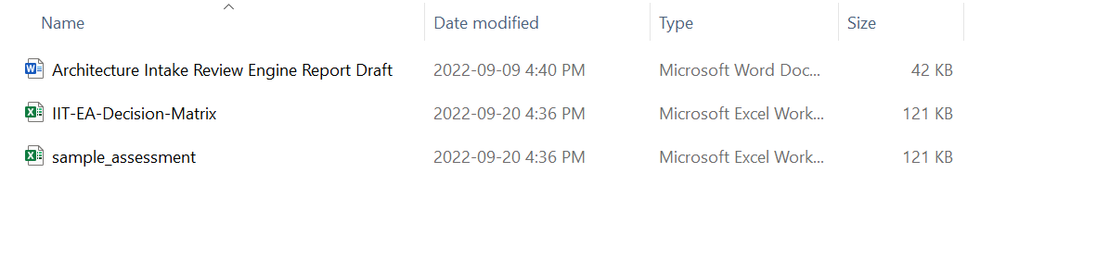
Input files
Directory: data/input/pre_agp0
Architecture Intake Review Engine Report Draft: Base Template. Text extracted from ‘IIT-EA-Decision Matrix’ and ‘sample_assessment’ is inserted here.
IIT-EA-Decision-Matrix: An Excel file that has rubrics
Sample_assessment: A sample risk assessment file submitted by a solution branch. Used for testing purpose.

Slide 3
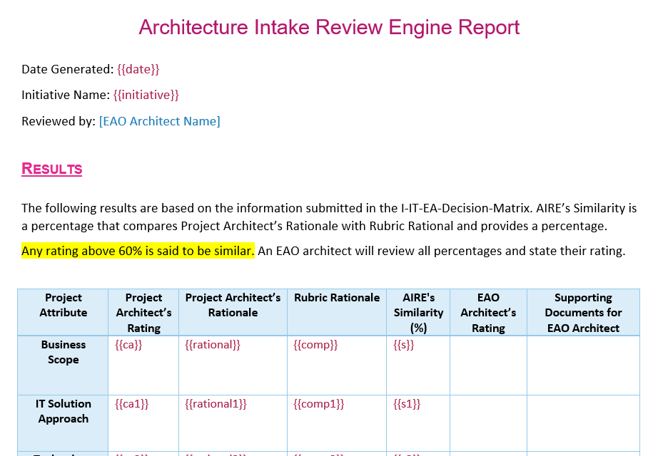
Architecture Intake Review Engine Report Draft
Architecture Intake Review Engine Report Draft: Base Template. Text extracted from ‘IIT-EA-Decision Matrix’ and ‘sample_assessment’ is inserted here
Text extracted from ‘IIT-EA-Decision Matrix’ and ‘sample_assessment’ is inserted here

Slide 4
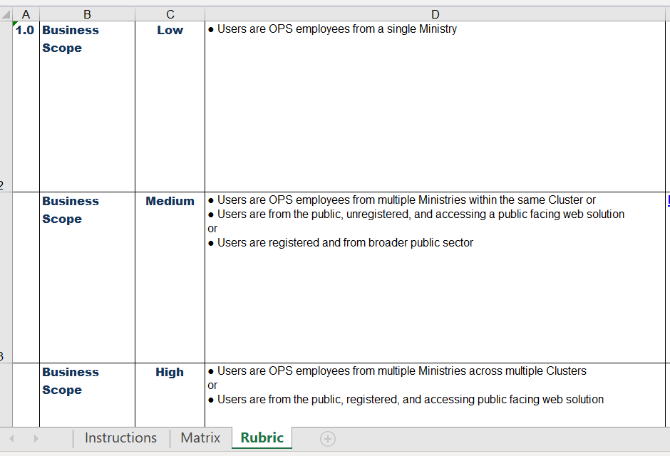
IIT-EA-Decision-Matrix
IIT-EA-Decision-Matrix: an Excel file that has rubrics. Go to the ‘Rubric’ sheet to see the rubrics.
There are 5 attributes: Business Scope, IT Solution Approach, Technology Update and/or Data Migration, Information Requirements, Information Sensitivity Rating
There are 3 risk ratings for each categories: Low, Medium, High
v
Rubric rationale for Business Scope attribute’s low risk rating
Rubric rationale for Business Scope attribute’s low risk rating
Rubric rationale for Business Scope attribute’s low risk rating
‘Rubric’ sheet

Slide 5
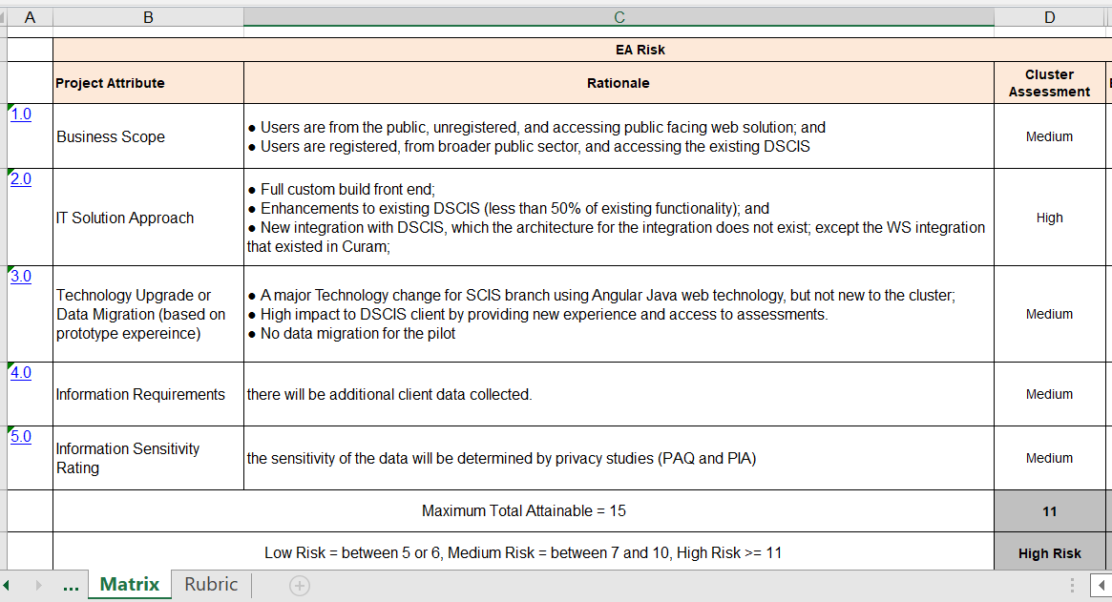
Sample_assessment
Sample_assessment: a sample risk assessment file submitted by a solution branch. used for testing
Go to the ‘Matrix’ sheet to see the risk assessment. Text in this sheet is extracted to be inserted into the template
Rubric rationale for Business Scope attribute’s ‘Medium’ risk rating
Risk of the Business Scope attribute of this project is rated as ‘Medium’
Total risk score
Comprehensive risk rating
‘Matrix’ sheet

Slide 6
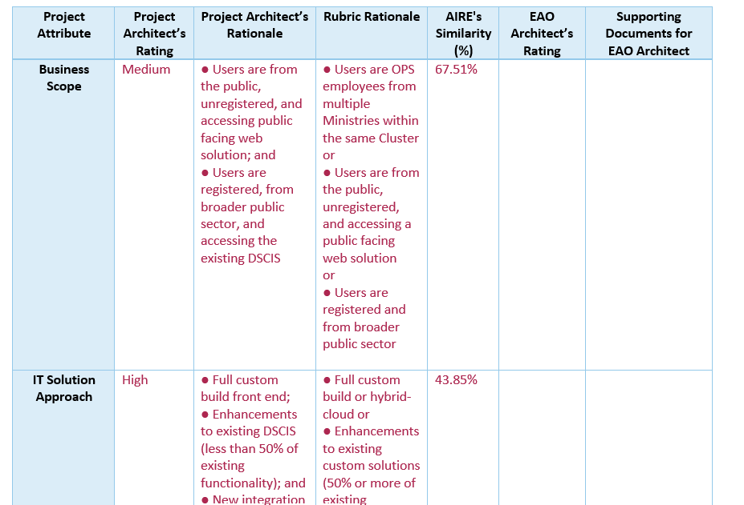
Final Output – Assessment_Report.docx
‘Architecture Intake Review Engine Report Draft’ is filled with text extracted from ‘IIT-EA-Decision-Matrix’ and ‘Sample_assessment’. And also, similarity ratio of submitted rationale and rubric rationale calculated by an algorithm.
Text extracted from ‘IIT-EA-Decision-Matrix’
Text extracted from ‘Sample_assessment’
Similarity ratio

Slide 7
How to fill in
Prepare a dictionary that has all key required in the template and values for each key
context = {
'date': get_today_date_time(),
'initiative': initiative_name,
'score': risk_score, …
}
2. Render the dictionary to the template
doc.render(context)

Slide 8
Functions
def run(initiative_name: str, assessment_file_directory: str) -> None:
def generate_pre_agp_0_report(initiative_name, assessment_file_directory) -> None:
def get_assessment_data(assessment_file_directory) -> list:
def split_assessment_data(assessment_data) -> tuple:
def fill_in_template(initiative_name: str, attribute_levels: list, risk_score: int, rationales: list, corporate_or_cluster: str) -> None:
def generate_template() -> DocxTemplate:
def get_similarity(rubric_text: str, rationale_text: str) -> float:
def get_rubric_descriptions() -> list:
def get_today_date_time() -> datetime:
def get_risk_level(risk_score: int) -> str:
def get_attribute_score(attribute_level: str) -> int:
def save_output(doc: DocxTemplate) -> None:
def open_output_file() -> None:

Slide 9
Function Flow
call run
call generate_pre_agp0_report
call get_assessment_data
call split_assessment_data
call fill_in_template
call generate_template
call get_rubric_description
call get_today_date_time
call get_risk_level
call get_attribute_score
call get_similarity
call save_output
call open_output_file

Slide 10
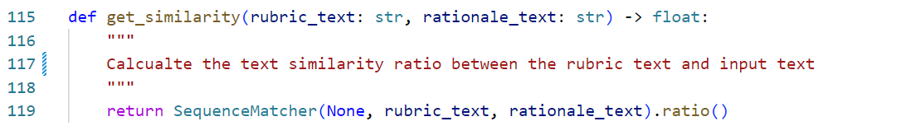
Calculating Text Similarity
get_similarity function calculates the similarity ratio of submitted rationale and rubric rationale.
Currently, SequenceMatcher(compares pairs of sequences) is used for similarity calculation algorithm.
The accuracy of similarity can be improved by replacing SequenceMatcher with a deep learning NLP model.

Slide 11
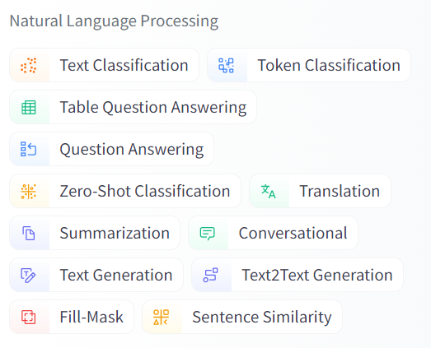
NLP model
There are lots of open source NLP models and they can be found in several websites.
For example, https://huggingface.co/models
Or other websites.
NLP Models can be found below ‘Natural Language Processing’ category at the left bar at the link above.

